Slide 1
Impact of Science Conference the Parallel Session on
Entrepreneurship
23rd June, 2021

Slide 2
Impact of Science
23-25 June, 2021
Overview of the Speakers
David Priilaid (Chair): Head of Applied Management, University of Cape Town, South Africa
Emma Salgard Cunha: Project Lead of Arts, Humanities, and Social Sciences at Cambridge Enterprise, United Kingdom
Magnus Gulbrandsen: Professor in TIK Centre for Technology, Innovation, and Culture, Oslo, Norway
#IOS21

Slide 3
Impact of Science
23-25 June, 2021
David Priilaid
Head of Applied Management, University of Cape Town, South Africa
#IOS21

Slide 4
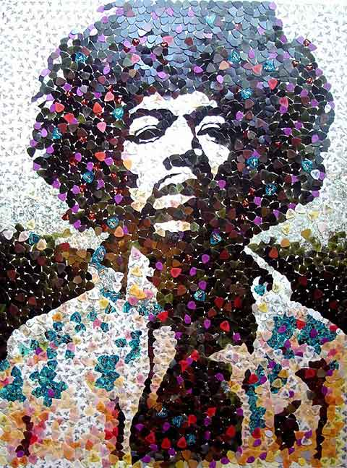
Unlocking CREATIVITY in the 21st Century
A-Prof David Priilaid.
School of Management Studies
University of Cape Town
James Dean

Slide 5
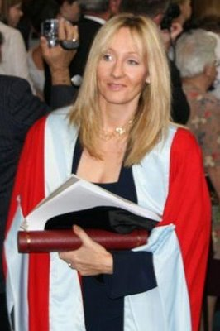
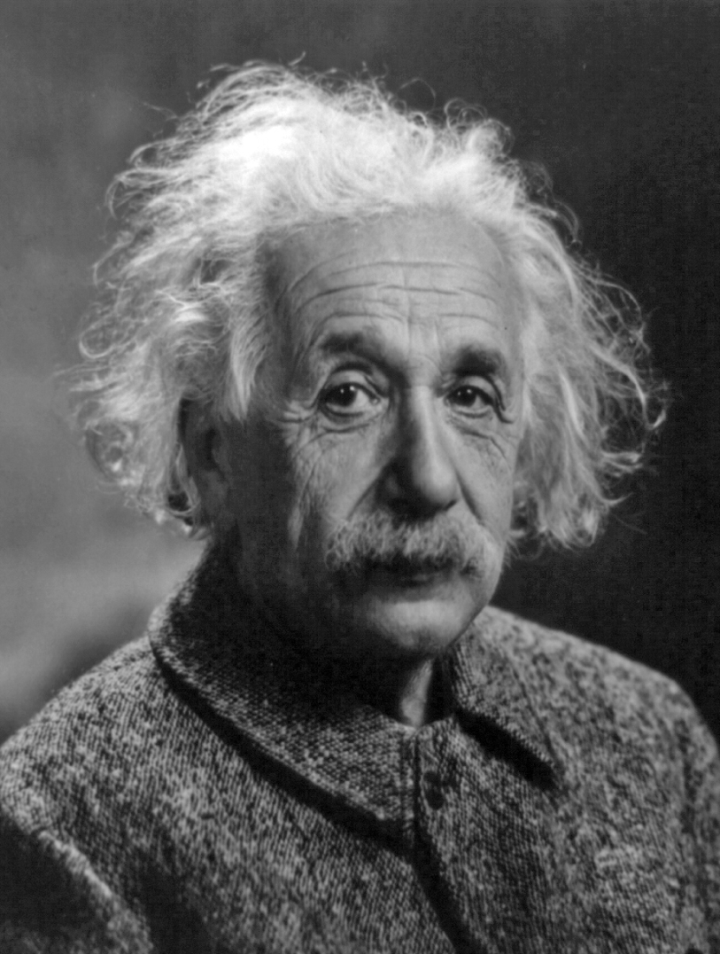
The true sign of intelligence is not knowledge but imagination.
Albert Einstein
I want to extol the crucial importance of imagination.
J. K. Rowling
James Dean

Slide 6
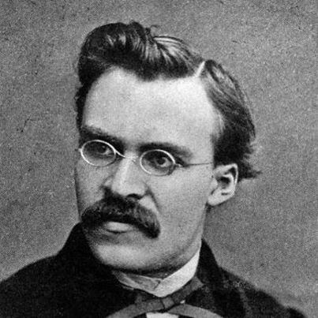
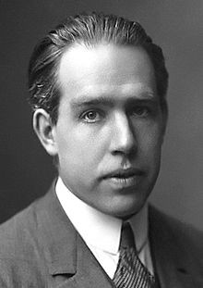
Science should be viewed
from the perspective of the artist.
Friedrich Nietzsche (1844-1900)
“When it comes to atoms,
language can be used only as
poetry.”
Danish Scientist Niels Bohr (1885-1962 : Nobel Prize 1922).
James Dean

Slide 7
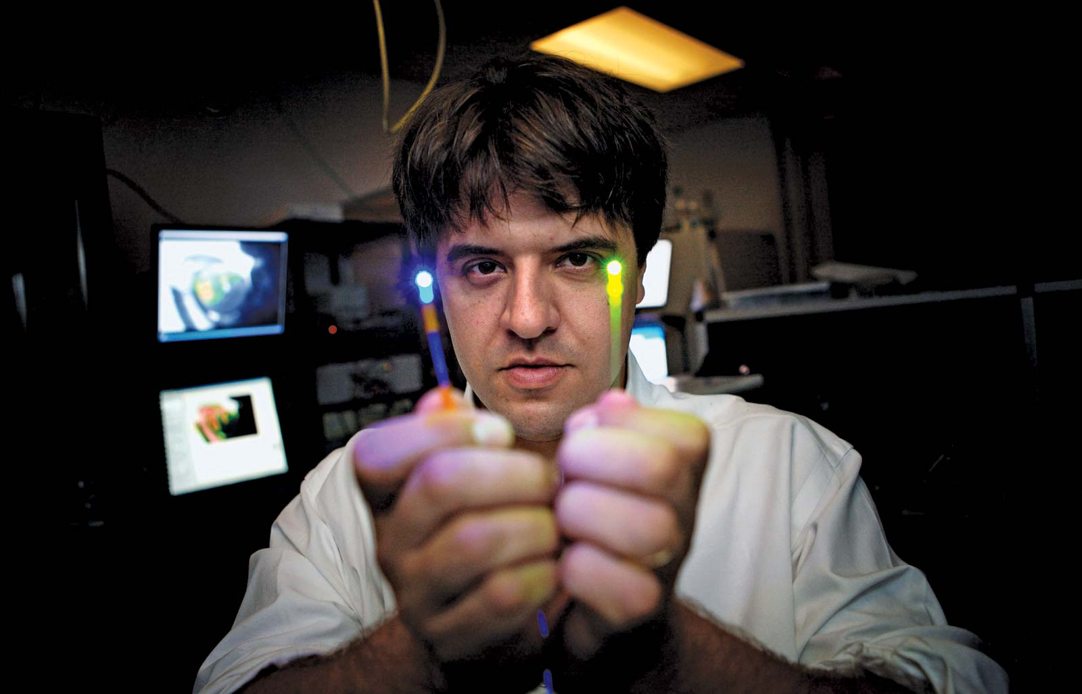
Karl Deisseroth
Professor of Bioengineering and of Psychiatry and Behavioral Sciences at Stanford University.
2018 winner of the Kyoto Prize for lifetime achievement in the arts and sciences.
“That was my first love and vocation: I wanted to be a writer.”

Slide 8
Where do great ideas come from?

Slide 9
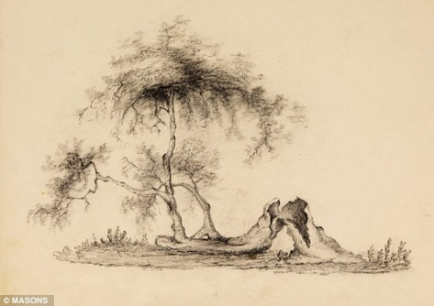
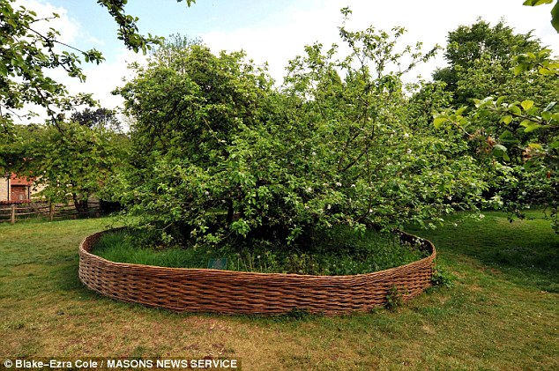
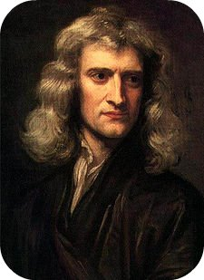
Isaac Newton
(1642-1727)
Newton was relaxing in an orchard when an apple fell on his head.
Prompted him to initiate his theories on gravity and his great work, The Principea.

Slide 10
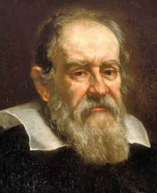
Galileo
(1564-1642)
Astronomer
Developed his ideas on using a pendulum to mark time while sitting alone in a church and watching the movement of massive chandeliers.

Slide 11
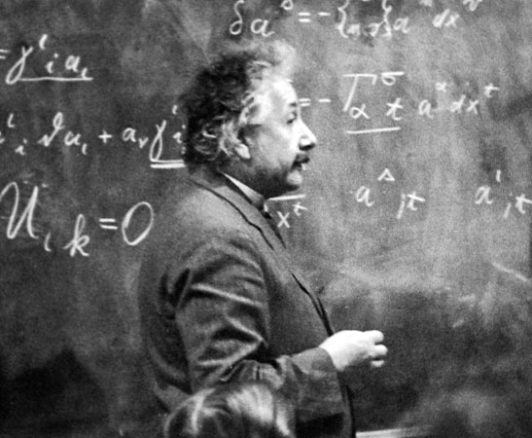
INSIGHTS FROM QUIET WATER: AWAKE (3)
Albert Einstein
(1879-1955)
Inventor of Relativity
Einstein first developed his theories on his famous E = MC2 equation while sitting on a train going to and from his work in a patent office in Bern, Switzerland.

Slide 12
ROCK ‘n ROLL AS INSIGHT

Slide 13
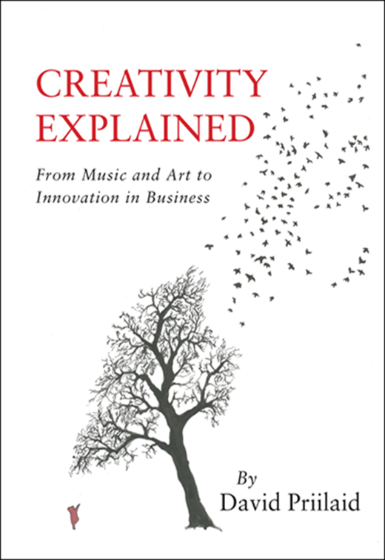

Slide 14
Being & Action
“Download” of great ideas
Universal Bank (4)
Serendipity
Not thinking (5)
Instinct / Intuition
The Ceiling
“Setting the Table” (8)
Willing to improvise (2)
Action
Hours 1-10000
Practice (7)
Perspective
Observation skills (5)
Self taught (6)
No playlists (2)
Artistic Freedom (5)
Workaholic (3)
Persistence / Proactivity (7)
Pathology
Hearing “No” (4)
Pre-Action
Addiction Drugs (4)
Authenticity (5)
Depression (5)
100% Commitment (4)
Creating from a wound (5)
Childhood
Profound Early Connection (6)
Outsider
Exiled Child (7)
Suffering
Love
Resilience

Slide 15
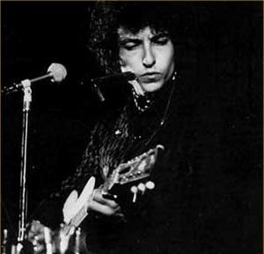
ZONE CHANNELING
Bob Dylan,
(1941-)
An American musician, singer-songwriter, music producer, artist, and writer.
“They just came through me.
It wasn’t like I was having to compose them”

Slide 16
ZONE CHANNELLING
Leonard Cohen,
(1934-)
Canadian singer-songwriter, musician, poet, and novelist.
“If I knew where the good songs came from I would go there more often.”
At the 2011 Prince of Asturias Awards:

Slide 17
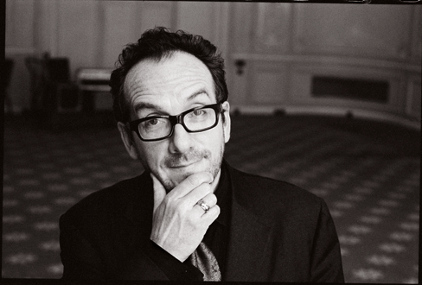
ZONE CHANNELLING
Elvis Costello,
(1954-)
English singer-songwriter.
“I don’t want to sound spiritual but I try to make an antenna out of myself, a lightning rod out of myself, so that whatever is out there can come in.”

Slide 18
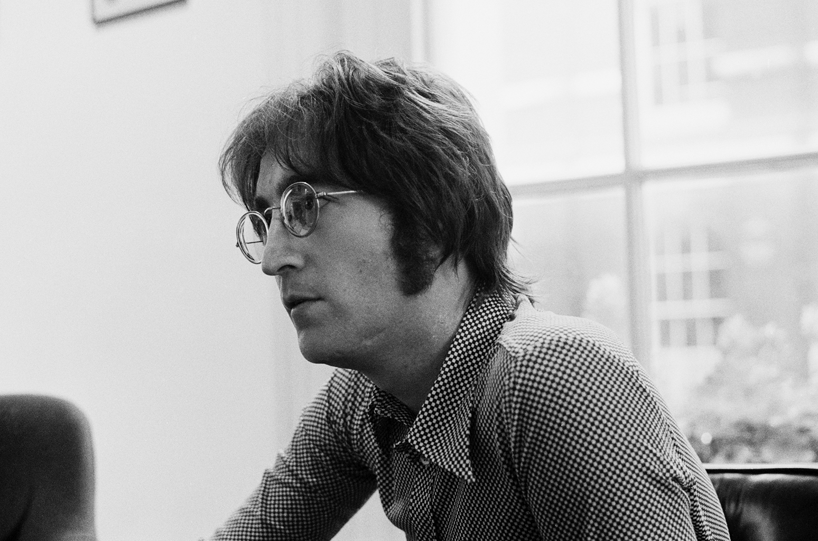
ZONE CHANNELING
John Lennon:
On writing
Nowhere Man
…I just lay down and tried not to write, and then this came out…
…The whole thing came
out in one gulp.

Slide 19
ZONE CHANNELING
The Beatles song writer literally dreamt up the classic “Yesterday” after hearing the tune played by a string orchestra in his sleep.
Paul Mc Cartney
(b. 1942)
James Dean

Slide 20
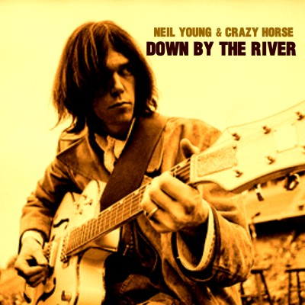
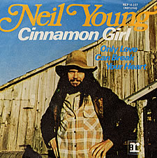
ZONE CHANNELLING
On a bad dose of flu, a semi-conscious Neil Young wrote three epic tunes:
“Cinnamon Girl”,
“Cowgirl in the Sand”, and
“Down by the River.”
All in one day!
Neil Young
(b. 1945).
Singer Song-writer.

Slide 21
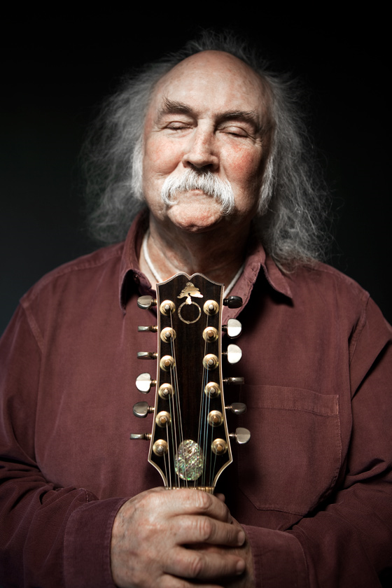
ZONE CHANNELLING
David Crosby
(b. 1941)
“I didn’t have control over
what comes out of my pen”.

Slide 22
Being & Action
“Download” of great ideas
Universal Bank (4)
Serendipity
Not thinking (5)
Instinct / Intuition
The Ceiling
“Setting the Table” (8)
Willing to improvise (2)
Action
Hours 1-10000
Practice (7)
Perspective
Observation skills (5)
Self taught (6)
No playlists (2)
Artistic Freedom (5)
Workaholic (3)
Persistence / Proactivity (7)
Pathology
Hearing “No” (4)
Pre-Action
Addiction Drugs (4)
Authenticity (5)
Depression (5)
100% Commitment (4)
Creating from a wound (5)
Childhood
Profound Early Connection (6)
Outsider
Exiled Child (7)
Suffering
Love
Resilience

Slide 23
Impact of Science
23-25 June, 2021
Emma Salgard Cunha
Project Lead of Arts, Humanities, and Social Sciences at Cambridge Enterprise, United Kingdom
#IOS21

Slide 24
Supporting Entrepreneurship within an Arts, Humanities and Social Science Research Culture
Dr Emma Salgård Cunha
Arts, Humanities and Social Sciences Project Lead
Cambridge Enterprise
emma.salgardcunha@enterprise.cam.ac.uk

Slide 25
Invention and creativity in academia
The action of coming upon or finding; the action of finding out; discovery (whether accidental, or the result of search and effort).
The action of devising, contriving, or making up; contrivance, fabrication… fiction, figment.
The faculty of inventing or devising; power of mental creation or construction; inventiveness.

Slide 26
Invention and creativity in academia

Slide 27
Invention and creativity in academia
“The language of entrepreneurship”

Slide 28
Arts, Humanities and Social Sciences at Cambridge
Inventive, excellent, specialized research across breadth of arts and humanities
Strong culture of public engagement including through the University’s museums and libraries; structural support also well established for high-impact policy research and influence
High level of freedom for basic research
Academic-led research culture – creative, entrepreneurial and open
Strategic research strengths in Digital Humanities, Global Challenges, Reproduction; focused research centres in Heritage and Language Sciences.

Slide 29
Arts, Humanities and Social Sciences at Cambridge
Inventive, excellent, specialized research across breadth of arts and humanities
Strong impact culture including public engagement; museums and libraries; high-impact policy research and influence
High level of freedom for basic research
Academic-led research culture and policies
Strategic research strengths in Digital Humanities, Global Challenges, Reproduction; focused research centres in Heritage and Language Sciences

Slide 30
Focus on freedom and variety of opportunities
Focus on strategic strengths and University priorities

Slide 31
Focus on strategic strengths and existing priorities
Working with existing partners of the University
Mapping onto grant funding and well-established research groups
Themed or challenge-based programmes
Tools to support/enhance existing impact activities
Notes:
Smart approach
Makes use of testbed/seed funding in cost effective way
Builds on e.g. consultancy services and similarly motivated
May develop a pipeline
Helps with prioritising
Helps with buy-in from key stakeholders
Presents commercialisation as a support rather than a challenge to status quo
Possibilities of finding groups of projects with commonalities- possible toolkit? Identify similar challenges and solve them communally
Can create cohorts of like minded people
Feels instrumental – we can help you, if you have a goal in mind!

Slide 32
Focus on freedom and variety of opportunities
A “take all comers” approach!
Looking to respond to specific (eclectic?) needs of each project
Support entrepreneurs who are outside of normal structures
Presenting commercialisation as novel and game-changing
Notes:
Don’t turn away unfamiliar/difficult projects
Avoid specialisation before you know what’s out there
Encourage creative or unusual approaches
Help short-term and precariously funded projects (and people) to make their impact sustainable
Discover new partners and build your networks in an ad hoc way
In charge of our own stories

Slide 33
Focus on strategic strengths and University priorities
Focus on freedom and variety of opportunities
Foster an entrepreneurial mindset,
build entrepreneurial skills to
enhance and scale the impact of research
in areas where there is top-down
or bottom-up impetus for action!

Slide 34
Arts, Humanities and Social Sciences at Cambridge Enterprise
AHSS Knowledge Transfer
Research Tools
Consultancy
Social Enterprise
Software
Something new!

Slide 35
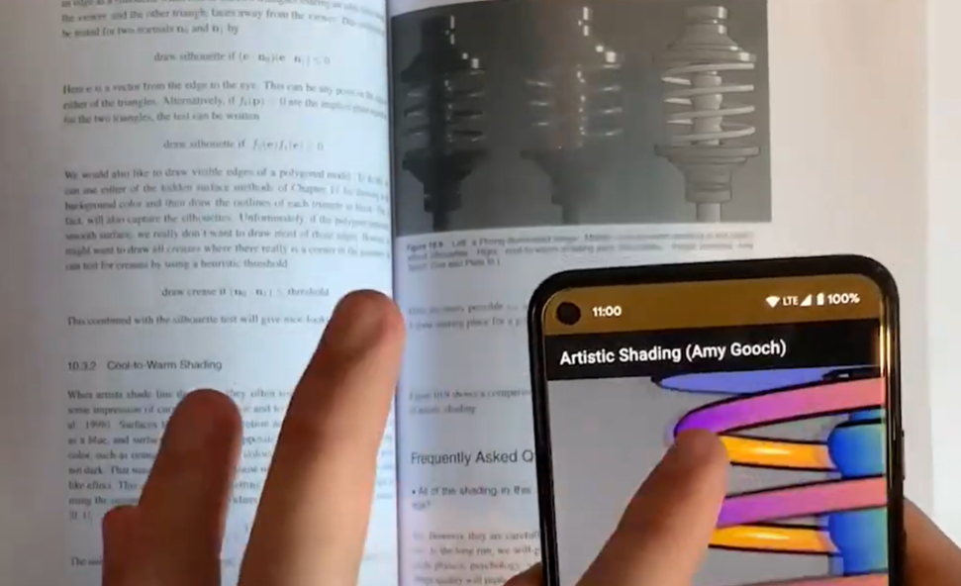
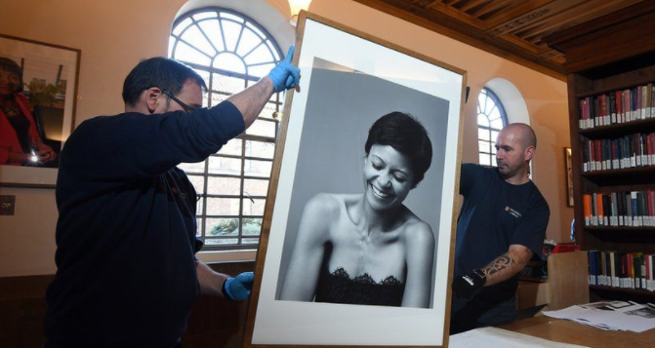
Humanities Innovation Week
User-focussed design training
Business model canvas
A structured pitch deck
Promise to support

Slide 36
Creative Cambridge
Making a community visible
Positioning commercialisation as a tool within existing best practice
Active network management long after the event
Giving context to interactions – not just “nice to meet you”

Slide 37
Thank you

Slide 38
Impact of Science
23-25 June, 2021
Magnus Gulbrandsen
Professor in TIK Centre for Technology, Innovation, and Culture, Oslo, Norway
#IOS21

Slide 39
Academic entrepreneurship and TTOs: narrow, broad and holistic views
Magnus Gulbrandsen, Professor
Oslo Institute for Research on the Impact of Science (OSIRIS), TIK Centre for Technology, Innovation and Culture, University of Oslo
Conference: AESIS Impact of Science 2021
Cape Town (digital), 23-25 June 2021
Notes:
Budskap: dette er et modent område. Hverken digitalisering eller biotek endrer på det. Low-tech aktive.
Rule of 3

Slide 40
Starting point
Theme of this session: entrepreneurship
Sub-question: How can and should science be made market-ready and how can you overcome the obstacles?
This is a common question – often asked by policymakers and university top managers – and the answer is often to establish a form of technology transfer office (TTO)
But is this a good question? What kind of response is a TTO?
I will reflect on this using my experience from studies of and involvement in entrepreneurship, commercialisation and TTOs

Slide 41
Narrow, broad and holistic views

Slide 42
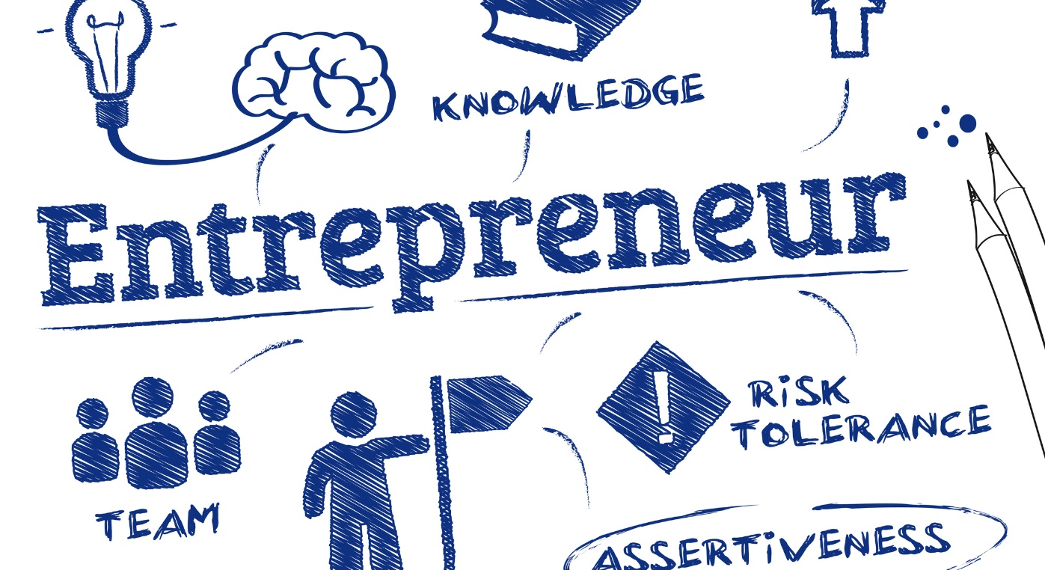

Slide 43
The narrow perspective
Entrepreneurship is primarily seen as the establishment of a new (commercial) firm
The founder is called an entrepreneur, or an academic/student entrepreneur when we talk about cases from universities
A main challenge is to get more people to become entrepreneurs, and TTOs and other organisations are set up to help them

Slide 44
The narrow view: some thoughts
Sometimes the activities of academics and students result in the establishment of a new firm
This is a rare occurence, however (many leading and wealthy research universities only create a handful of such firms every year)
Students and especially staff probably have weak incentives to become entrepreneurs

Slide 45
4400 Norwegian researchers
In the last three years I have…:

Slide 46
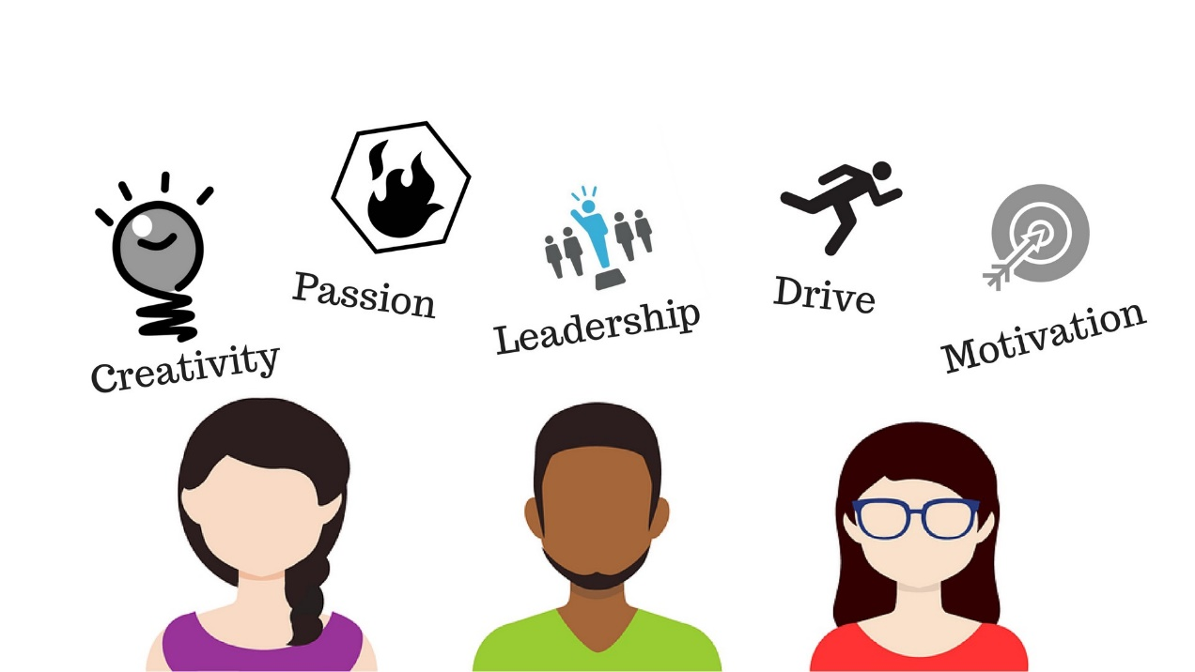

Slide 47
The broad perspective
Entrepreneurship is about creating and implementing ‘something new’
It does not have to be a firm – the main emphasis is on creativity and its results
TTOs may have a role in promoting creativity, but the role of the wider research and teaching environment is more important

Slide 48
The broad view – some thoughts
It encompasses many more activities and initiatives and can clearly help engage more staff and students
It challenges the narrow and economic/commercialisation perspective of some actors
It might not always be a good starting point for setting up TTOs

Slide 49
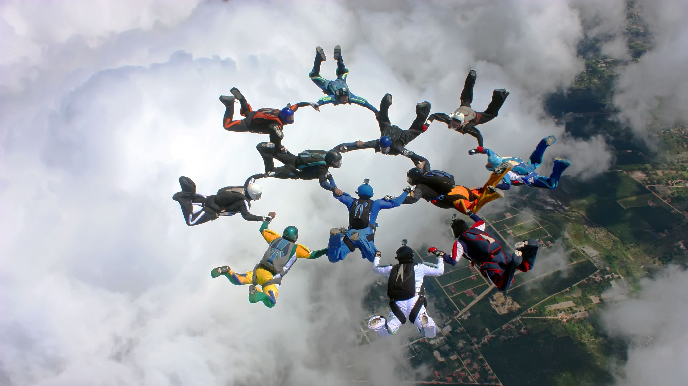
The holistic view

Slide 50
Entrepreneurs are part of a larger system – they need champions and other helpers, and they often encounter resistance
Few people may become entrepreneurs, but many can find themselves as potential champions or critics
What can universities do to stimulate champions and make critics act constructively?

Slide 51
Constructive criticism?
Can we really afford this?
How much will it cost in the long run?
Will it work in practice?
Who’s got time to work on it?
Does it send political signals?
Could it be dangerous?
Do we know if it is sustainable?
Do we know anything about it at all?
What about the exams and other stuff!?
These are twelve reasonable questions, in larger settings you might get a lot more
Unreasonable questions are probably also common
Can we train the ones asking the questions, not just the one behind the light bulb?
Do we have competence for this?
Hasn’t this been tried before?
Will our users accept this new thing?
Will it look good in social media?

Slide 52
Some thoughts on TTOs

Slide 53
What we know about TTOs (1)
Many of them are established with a narrow perspective on entrepreneurship
This is part of their mission and how they are governed by owners and other stakeholders
Few of them make a profit
Even ones at prestigious and research-intensive universities
The most (financially) successful ones are old and had an early lucky win
You need luck and you need patience and realistic assumptions from owners
You need sensible performance indicators and some basic funding

Slide 54
What we know about TTOs (2)
They are not entrepreneurs themselves
Their main role is often to ‘structure deals’ and act as facilitators – this is important (but you don’t get entrepreneurship by setting up a TTO)
They need to be able to handle conflicts and tensions
Not just unrealistic expectations but also possible lack of disclosure or unwillingness to collaborate from the entrepreneurs themselves
They might combine a narrow focus on spin-offs, intellectual property rights protection and finding investors with other activities:
Industrial liaison, student engagement, incubators and similar, early phase seed funding, training and consultancy, professional advice

Slide 55
What we know about TTOs (3)
Greed is not good
But how can it be avoided if TTOs have to find funding for their own activities constantly?
Learning is beneficial, emulation is problematic
What are the most important ‘local conditions’?
Moving towards the broad and holistic can be challenging
How can we introduce bigger ideas about societal impact and engagement in TTOs?

Slide 56
Main messages…
There are different relevant perspectives on entrepreneurship
My suggestion is to see it as something that can be both narrow (tied to commercialisation) and broad (tied to creativity), but first and foremost as a systemic phenomenon
We need to train people and establish support for all parts of this system, not just the entrepreneurs themselves
Entrepreneurship needs to be internalised in universities’ regular teaching and research, not something that only happens “later” and “on the outside”
TTOs may have a useful role – but if the role is broad support, they need to find ways to integrate their activities

Slide 57
Thank you
Email: magnus.gulbrandsen@tik.uio.no
Web: http://www.sv.uio.no/tik/english/research/projects/osiris/
Twitter: @OSIRIS_TIK and @magnusgulbr

Slide 58
Impact of Science
23-25 June, 2021
Thank you
#IOS21

